Slide 1
Comparisons using as…as…

Slide 2
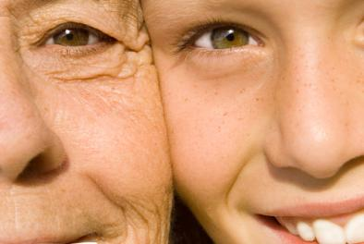
9-1 MAKING COMPARISONS WITH AS… AS
Jenn is not as old as Emma.
Emma
Jenn

Slide 3
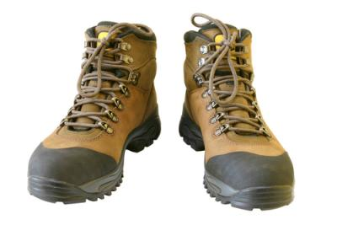
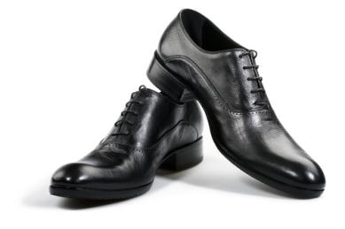
9-1 MAKING COMPARISONS WITH AS… AS
The boots and shoes are size 11.
The boots are as large as the shoes.
Size 11
Size 11

Slide 4
9-1 MAKING COMPARISONS WITH AS… AS
The boots and shoes are size 11.
The boots are as large as the shoes.
As…as parts are equal or same
as + adjective + as
Jenn is 25. Emma is 65. Emma is older than Jenn
Jenn is not as old as Emma.
not as…as parts are different
Not as + adjective + as

Slide 5
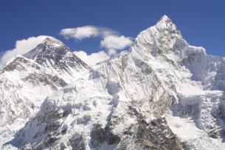
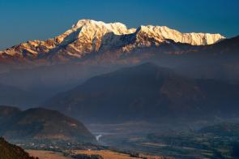
9-1 MAKING COMPARISONS WITH AS… AS
(c) Annapurna is not as high as Everest.
Everest - 8,848 m.
Annapurna – 8,091 m.

Slide 6
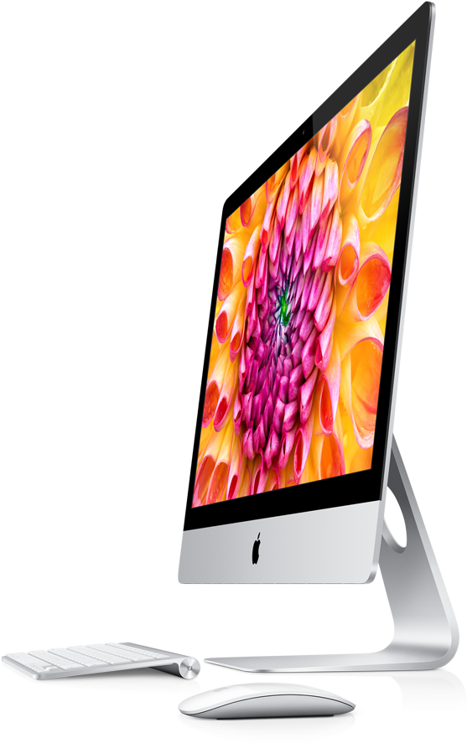
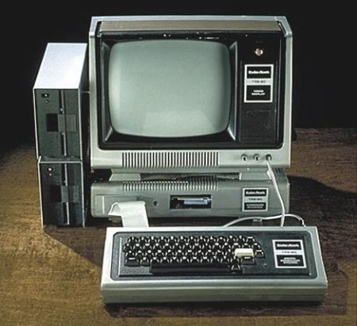
MAC
HP
Starts quickly
expensive
The HP does not cost as much as the iMac.
The HP does not work as quickly as the iMac.
The HP monitor weighs as much as the iMac.

Slide 7
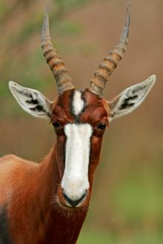
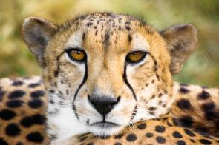
9-1 LET’S PRACTICE
as
An antelope can run ___ fast ___ a cheetah.
as
Cheetah 95 kph
Antelope 95 kph

Slide 8


9-6 COMPARISONS WITH LESS…THAN AND NOT AS… AS
Miko is not as happy as Amanda.
Miko
Amanda

Slide 9
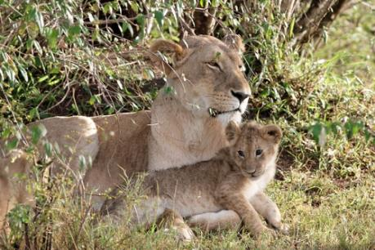
9-6 LET’S PRACTICE
as
A lion cub is ______ old ____ a mama lion.
not as

Slide 10
9-6 LET’S PRACTICE
as
A lion cub is _____ strong ____ a mama lion.
not as

Slide 12
Dan's house
Tom's house

Slide 13

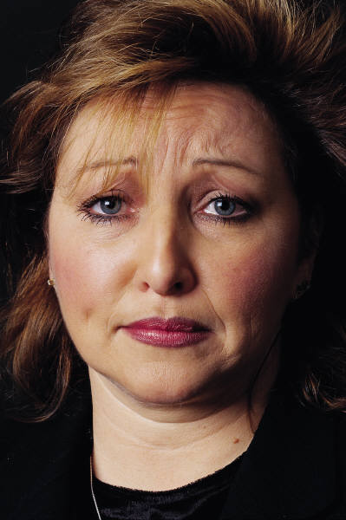
Rule 2:
Jan
Julie

